Slide 1

CAREER COMPASS SG · SECTION 2 OF 4
Process & Data Handling
How we transformed 1 million messy rows into actionable intelligence
MODULE ASSIGNMENT
OFFICIAL TIME ALLOCATION
Module 1 · Group 7
3:30 Mins)

Slide 2
PART 1
Data Architecture & Pipeline
Scaling Python & pandas ETL pipelines to process 273 megabytes across 1.05 million job records in 15 seconds.

Slide 3

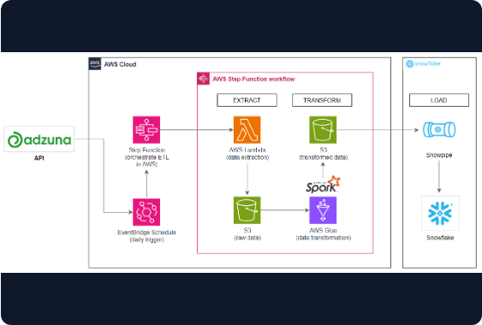
High-Speed Pipeline Strategy
Pure Python & Pandas Stack: Designed entirely around a high-performance ETL pipeline processing a raw 273 MB dataset (~1.05M rows).
50,000-Row Prototyping: Rules and transformations were first validated on a 50k row sample before scaling up to the full file.
Chunked Processing Strategy: The full dataset is read in 6 parallel chunks of 200,000 rows each to optimize memory consumption.
Sub-15s Parquet Runtime: Clean outputs are serialized to Apache Parquet format; dashboard never reads raw CSV files directly.

Slide 4




11 Rules, 1 Core Principle
The Core Cleaning Principle
"If a value is broken, blank the value but keep the row."
Deleting broken rows would severely corrupt total job count metrics. A posting with a missing or invalid salary still proves an active job position existed in Singapore.
Dropped Empty Columns
Fixed Salary Typing Errors
Capped Top 1% Outliers
One column was completely blank across all 1.05 million rows. Safely purged to reduce memory footprint.
Extreme top 1% executive pay packages were capped rather than deleted, preventing skewed average metrics.
~10,000 postings listed monthly pay as $180,000 (annual typed as monthly). Blanked salary, preserved posting.

Slide 5



Cleaning Impact & Rule Metrics
Data Cleaning Rule | Identified Issue | Action Taken | Data Preservation Impact
1. Blank Column Purge | 100% null entries across 1.05M records | Dropped column schema-wide | Zero row loss, memory optimized
2. Salary Typo Normalization | ~10,000 extreme values (e.g. $180k/mo) | Blanked invalid salary field | Row retained for job count volume
3. Outlier Percentile Capping | Top 1% executive pay skewing mean | Winsorized capping at 99th %tile | Averages stabilized without data loss
99.6%
99.0%
ROW SURVIVAL RATE POST-CLEANING
VALID SALARY DISCLOSURE RATE

Slide 6
PART 3
Data Quality & Traps Uncovered
How rigorous exploratory analysis prevented major statistical errors before dashboard integration.

Slide 7


Two Critical Traps Identified
Trap 1: False Positive Duplicates
Trap 2: Category Multi-Counting
Running standard duplicate checks initially flagged 289 rows as identical duplicate listings.
Jobs average 1.69 categories each, expanding total records from 1.04M to 1.66M when unnested.
The Reality: These records were generic template listings with blank unique IDs. Deleting them would have destroyed legitimate job posting evidence.
The Mistake: Aggregating jobs by category without de-duplicating unique job IDs overcounts Singapore's job market by 600,000+ postings!

Slide 8

The 1.66M Duplication Bug
Why Standard GroupBy Broke:
Multi-Label Schema: Postings regularly tagged with multiple sectors (e.g. "Tech" & "Finance").
NAIVE CATEGORY SUM
1.66M
1.69 Multiplying Factor: Unnesting category arrays inflates dataset by 62%.
vs. True Job Unique IDs: 1.04M
Our Solution: Enforced mandatory COUNT(DISTINCT job_id) across all dashboard charts.

Slide 9
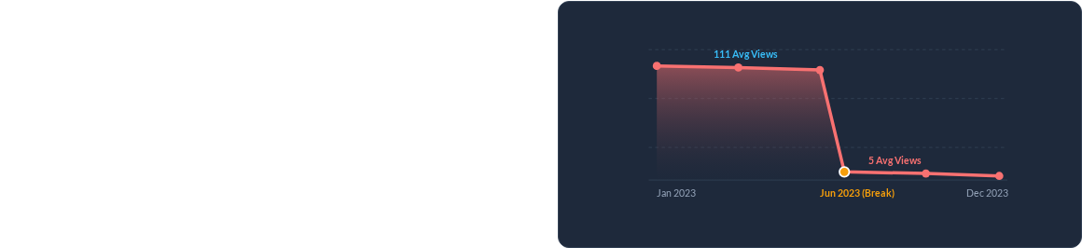
The June 2023 Structural Break
The Best Discovery in the Talk
Plotting engagement metrics across time revealed an unprecedented cliff edge in June 2023:
Average Views Collapse: Plunged from 111 views/job down to just 5 views/job overnight.
Zero-Applicant Spike: Postings with 0 applications surged from 18% to 79%.

Slide 10


Two Files Stitched Together
The Root Cause & Strategy
The dataset was secretly two different backend systems merged at June 2023. Post-June counters (views & applications) were frozen/unrecorded.
Our Golden Rule for the Dashboard:
• Use Full 1.04M Rows: For macro job counts, salary benchmarks, and industry breakdown.
• Restrict to ~200k Pre-June Rows: When analyzing user engagement, views, and competition ratios.

Slide 11
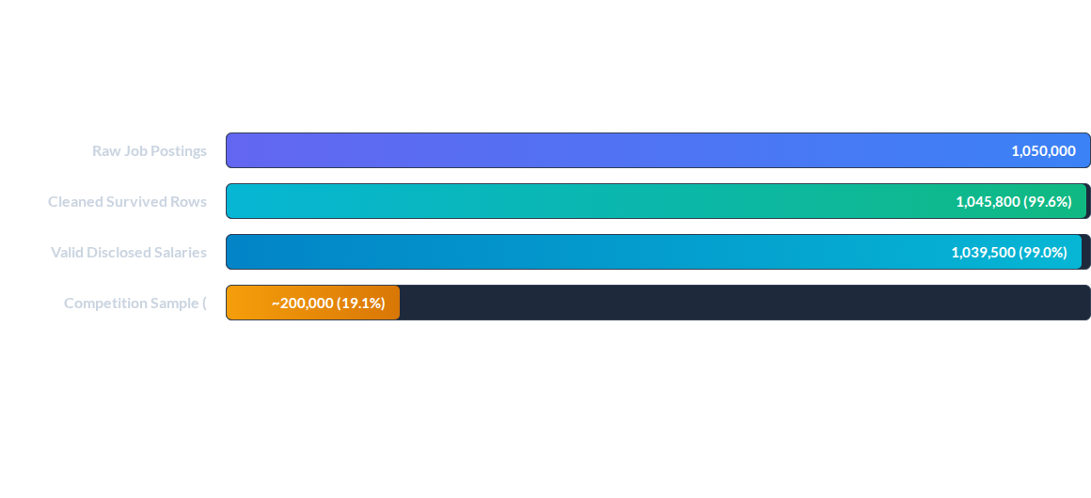
Key Data Metrics Known Cold
"Protect Part 4: The June 2023 story is our strongest empirical finding and must be defended under Q&A."

Slide 12

Defensive Q&A Ready
Data cleaned. Traps resolved. System boundary established.
Handover to Section 3 (App Walkthrough)
"That's the data. Now let's see the dashboard we built on top of it."
Career Compass SG · Group 7 Timing Budget: 3:30 / 4:00

